Slide 1
DAYANANDA SAGAR UNIVERSITY
SCHOOL OF ENGINEERING
Department of Computer Science and Technology
Cloud Application Development Mini Project
Online Voting System
Under the Supervision
Prof. Santosh Kumar
Presented By:
Prajjwal Mishra-ENG20CT0018
Aditya navale-ENG20CT0003
Ansh Gupta-ENG20CT0005

Slide 2
Overview
Introduction
Problem Statement
Hardware & Software Requirements
Testing and Result
References

Slide 3
Introduction
Online voting systems are electronic voting systems that allow voters to cast their votes remotely using the internet. They are becoming increasingly popular around the world, particularly as more people have access to the internet and as concerns about the security and efficiency of traditional paper-based voting systems continue to grow.
An online voting system is a digital platform that allows eligible voters to cast their votes in an election through the internet, without the need to physically visit a polling station. The system is typically designed to ensure the security, privacy, and accuracy of the voting process.
One of the key advantages of an online voting system is its convenience, as voters can cast their ballots from any location at any time, as long as they have internet access.
Online voting systems can also potentially increase voter participation, particularly among young and tech-savvy voters who may be more inclined to vote if they can do so online. Additionally, the use of online voting systems can reduce costs associated with traditional voting methods, such as printing and distributing physical ballots and staffing polling stations.

Slide 4
Problem Statement
Traditional methods of voting such as paper ballots and electronic voting machines have several drawbacks such as time-consuming, costly, and prone to errors. Moreover, these methods are not easily accessible to remote voters, and there is a need for a more efficient and secure way of conducting elections.
An online voting system can offer a solution to these problems
Therefore, the problem statement for an online voting system is to design and develop a secure, efficient, and user-friendly platform that ensures the accuracy and integrity of the voting process while also guaranteeing the confidentiality of voters' personal information. The system should be accessible to all eligible voters, including those with disabilities, and should be able to handle a large volume of users simultaneously without compromising its performance. Additionally, the system should be designed to prevent any attempts at fraud, such as voter impersonation or vote tampering, and ensure that each vote is counted only once.

Slide 5
Hardware & Software Requirements
Hardware Requirements
•Processor: Pentium
•RAM: 4GB
•Hard Disk: 1TB
•Speed: 1.1GHz
Software Requirements
•Operating System: Windows
•Back-End: MYSQL
•Front-End: HTML and CSS3
•Type: Web Application.

Slide 6
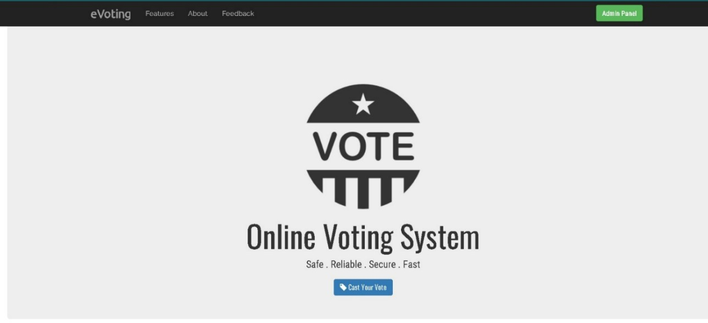
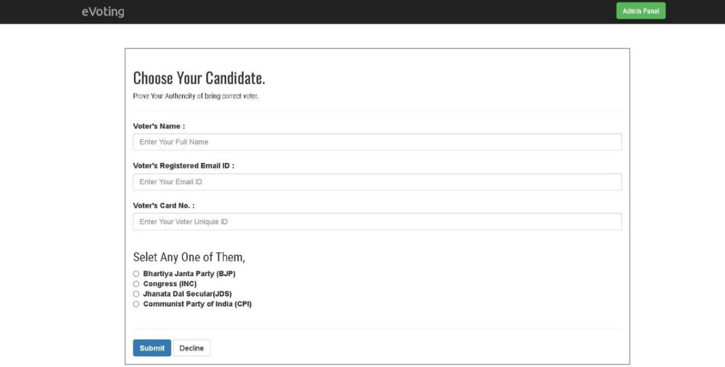
Testing and Result

Slide 7
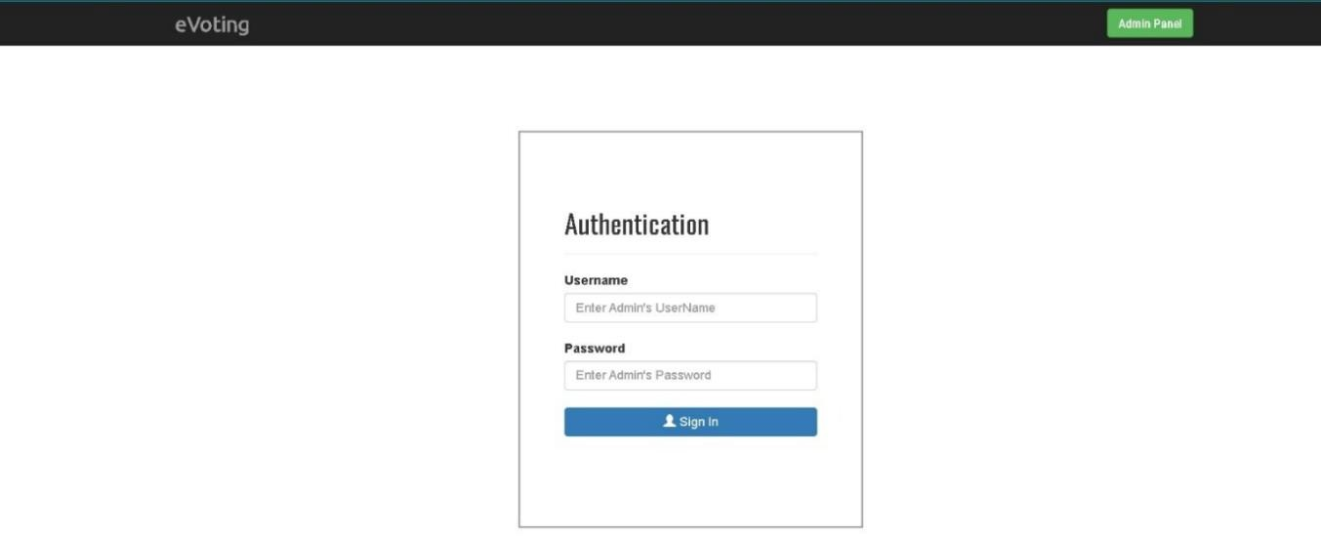
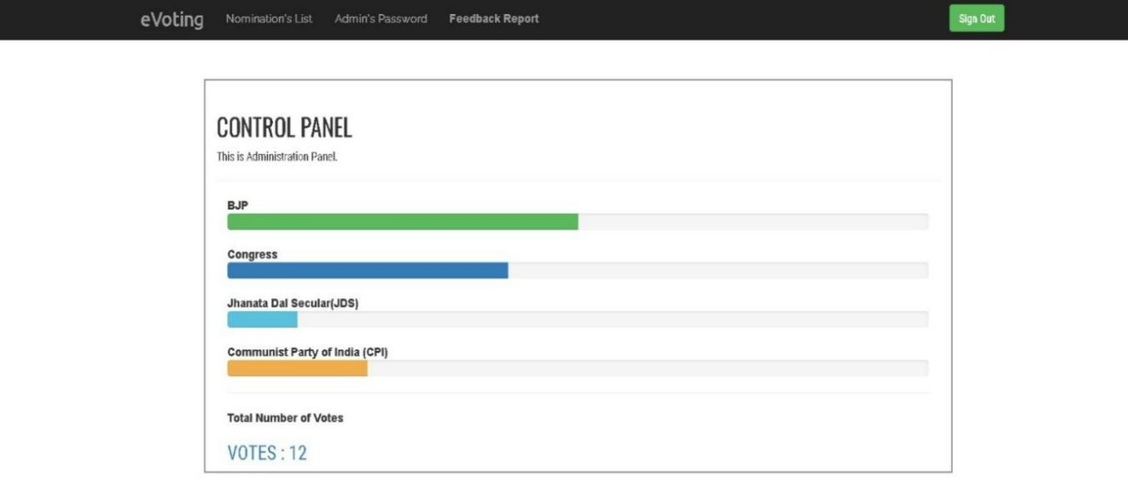

Slide 8
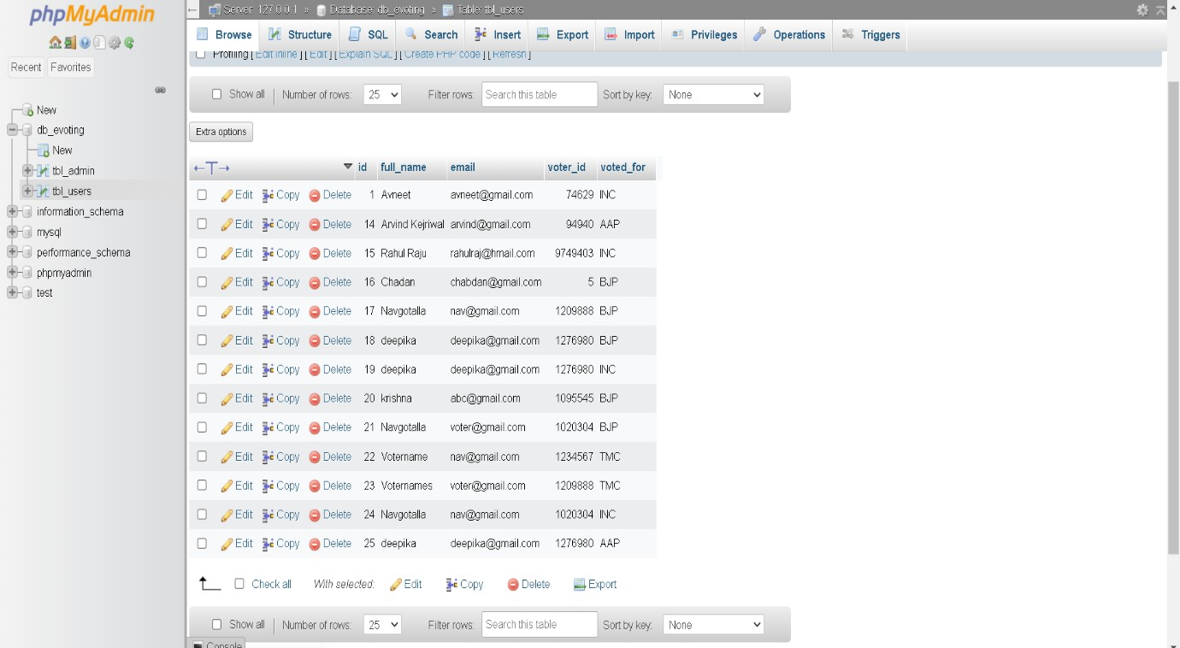

Slide 9
References
https://www.eballot.com/votes-and-elections/what-is-an-online-voting-system
https://transmitter.ieee.org/makerproject/view/91d35
https://www.polyas.com/online-voting/how-it-works

Slide 10
THANK YOU

